Slide 1
Session – 8
Building Requirements Model

Slide 2
Elements of the Requirements Model
The specific elements of the requirements model are dictated by the analysis modeling method that is to be used. However, a set of generic elements is common to most requirements models.
Scenario-based elements
Class-based elements
Behavioral elements
Flow-oriented elements
Analysis Patterns

Slide 3
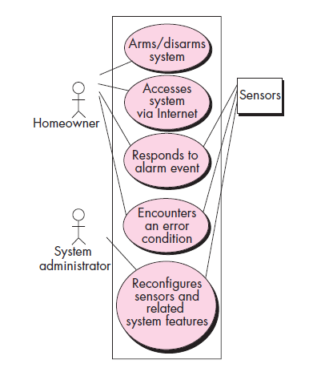
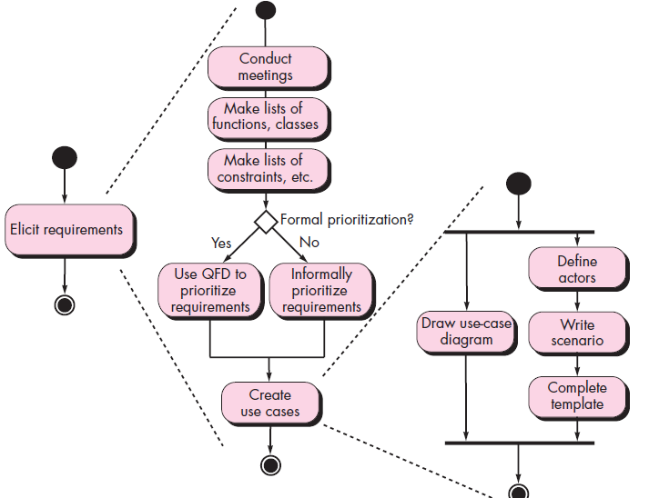
Scenario-based elements
Use Case Diagram for Safe home
Activity Diagram for safe home

Slide 4
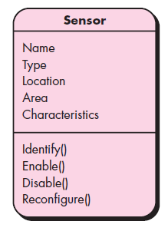
Class-based elements
Class Diagram for Sensor

Slide 5
Negotiating Requirements
Boehm [Boe98] defines a set of negotiation activities at the beginning of each software process iteration. Rather than a single customer communication activity, the following activities are defined:
1. Identification of the system or subsystem’s key stakeholders.
2. Determination of the stakeholders’ “win conditions.”
3. Negotiation of the stakeholders’ win conditions to reconcile them into a set of win-win conditions for all concerned (including the software team).

Slide 6
Validating Requirements
Verification
  designing the product right
Validation
  designing the right product
The formality gap
  validation will always rely to some extent on subjective means of proof
Management and contractual issues
  design in commercial and legal contexts
Real-world
requirements
and constraints
The formality gap

Slide 7
Validating Requirements
In the Validation process few questions should be asked and answered to ensure that the requirements model is an accurate reflection of stakeholder needs and that it provides a solid foundation for design.

Slide 8
Validating Requirements
Is each requirement consistent with the overall objectives for the system/product?
Have all requirements been specified at the proper level of abstraction? That is, do some requirements provide a level of technical detail that is inappropriate at this stage?
Is the requirement really necessary or does it represent an add-on feature that may not be essential to the objective of the system?
Is each requirement bounded and unambiguous?
Does each requirement have attribution? That is, is a source (generally, a specific individual) noted for each requirement?

Slide 9
Cont..
Do any requirements conflict with other requirements?
Is each requirement achievable in the technical environment that will house the system or product?
Is each requirement testable, once implemented?
Does the requirements model properly reflect the information, function, and behavior of the system to be built?
Has the requirements model been “partitioned” in a way that exposes progressively more detailed information about the system?
Have requirements patterns been used to simplify the requirements model? Have all patterns been properly validated? Are all patterns consistent with customer requirements?

Slide 10
SRS Vs User Stories
User Stories
Provide a small scale and easy to use presentation of information. Are generally formulated in the everyday language of the user and contain little detail, thus remaining open to interpretation. They should help the reader understand what the software should accomplish.
Must be accompanied by acceptance testing procedures for clarification of behavior where stories appear ambiguous.
SRS
Software requirements specification establishes the basis for an agreement between customers and contractors or suppliers on how the software product should function.

Slide 11
Questions
1.Develop a complete use case for one of the following activities:
  a. Making a withdrawal at an ATM
  b. Using your charge card for a meal at a restaurant
  c. Buying a stock using an on-line brokerage account
  d. Searching for books (on a specific topic) using an on-line bookstore.
Develop a checklist for conducting a requirements gathering meeting.
3. Why do we say that the requirements model represents a snapshot of a system in time?
4. Why is it that many software developers don’t pay enough attention to requirements engineering? Are there ever circumstances where you can skip it?
5. Discuss some of the problems that occur when requirements must be elicited from three or four different customers.
6. Define the metrics for specifying the NON-functional Requirements.
7. Discuss in detail the user Requirements?
8. Elaborate on software requirements document in detail?

